Slide 1


Beyond MEM: Bayesian spectral reconstruction for lattice QCD
Alexander Rothkopf
Institute for Theoretical Physics
Heidelberg University
References:
A.R.: J.Comput.Phys. 238 (2013) 106-114
Y. Burnier, A.R.: Phys.Rev.Lett. 111 (2013) 182003
S.Kim, P.Petreczky, A.R.: arXiv:1409.3630 t.b.p. in PRD
Y.Burnier, O. Kaczmarek, A.R.: arXiv:1410.7311 t.b.p in PRL
The Royal Society, International Scientific Seminar on Heavy Quarks, Chicheley Hall, UK (January 28th 2015)

Slide 2
The Bayesian strategy revisited
Task: Extract from N_{τ} noisy data points D_{i} the spectrum ρ_{l} at N_{ω}>>N_{τ} frequencies
Ill-posed: simple χ² fit of ρ_{l} to D_{i} is underdetermined, i.e. no unique answer
Bayes Theorem: Systematic inclusion of additional prior knowledge (I)
Likelihood: How is the data measured
Prior: What else is known about ρ
(functional form of S and default model m: δS/δρ|_{ρ=m}=0)
Notes:
D(\tau)=\int \,d\omega \,K(\tau,\omega)\,\rho(\omega)
D(\tau_i)=D_i=\sum_{l=1}^{N_\tau}\, \Delta\omega_l\, K_{ij}\, \rho_l
D^\rho_i=\sum_{l=1}^{N_\omega}\, \Delta\omega_l\, K_{ij}\, \rho_l
P[D|\rho,I]=e^{-L},\; L=\frac{1}{2} \sum_i (D_i - D^\rho_i)^2/\sigma_i^2
P[\rho|D,I]=\frac{P[D|\rho,I]P[\rho|I]}{P[D|I]}
P[\rho|D,I]\propto P[D|\rho,I]P[\rho|I]
P[\rho|I]=e^{S},\; S=\left\{
\begin{array}{lr}
\int d\omega (\rho-m-\rho log[\frac{\rho}{m}])\\
\int d\omega (1-\frac{\rho}{m}+log[\frac{\rho}{m}]\;\;)
\end{array}
\right.
P[\rho|I]=e^{S},\; S=S[\rho(\omega),m(\omega)]
\frac{\delta P[\rho|D,I]}{\delta \rho_l}\overset{!}{=}0

Slide 3
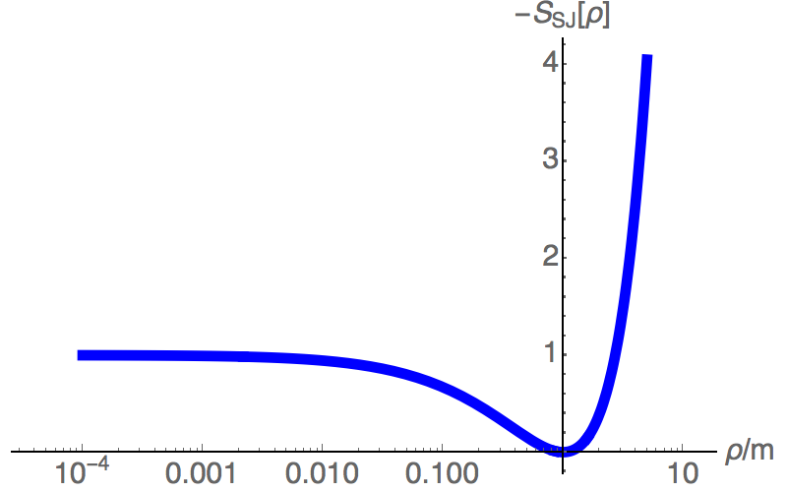
Standard MEM and Beyond
MEM: Prior functional is Shannon-Jaynes Entropy
Asakawa, Hatsuda, Nakahara,
Prog.Part.Nucl.Phys. 46 (2001) 459
all possible discrete ρ`s
weight α between L and S self-consistently det.
but requires uncontrolled Gaussian approx.
m
Search space for δP/δρ restricted to N_{τ} dim.
(works well if m close to correct ρ^{MEM} and N_{τ} large)
unique ρ^{MEM}:
δP^{MEM}/δρ=0
SVD space
N_{τ} dim, m dep.
ext.
SVD space
MEM solution in general not in SVD subspace:
extend search space.
A.R.: J.Comput.Phys. 238 (2013) 106
all ρ with L[ρ]≤N_{τ}
Difficulty: S_{SJ} posesses flat directions for ρ<<m.
In practice no convergence to machine precision.
Notes:
Different Bayesian answer depending on choice of S!
S_{SJ}=\alpha \int d\omega \big( \rho-m-\rho log\big[ \frac{\rho}{m} \big] \big)

Slide 4
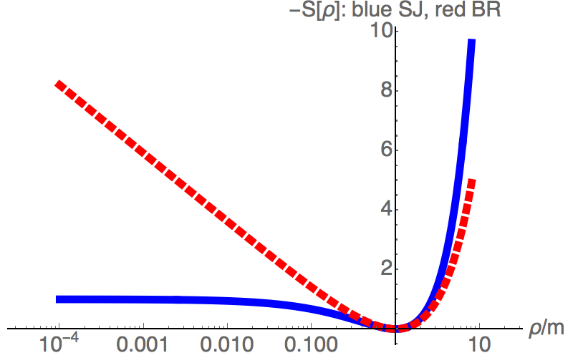
A new Bayesian Reconstruction Approach
New prior: (1) favors smooth ρ and guarantees (2) result independent of units
Y. Burnier, A.R.: Phys.Rev.Lett. 111 (2013) 182003
all possible discrete ρ`s
Assume ignorance about weight α, i.e P[α]=1
and integrate out from Bayes theorem expl.
unique ρ^{BR}:
δP^{BR}/δρ=0
m
If correct ρ were known, it leads to L[ρ]～N_{τ}
No apriori restriction on search space: due to
convexity of -S_{BR}, unique answer still exists
Asakawa, Hatsuda, Nakahara, Prog.Part.Nucl.Phys. 46 (2001) 459
all ρ with L[ρ]=N_{τ}
all ρ with L[ρ]≤N_{τ}
S_{BR} steeper than S_{SJ} at ρ<m but weaker for ρ>m
S_{BR} better for resolving peaks but weaker in suppressing numerical ringing
Notes:
S_{BR}=\alpha \int d\omega \big( 1-\frac{\rho}{m}+ log\big[ \frac{\rho}{m} \big] \big)

Slide 5
The BR method in practice (I)
First test scenario: mock spectrum analysis of three widely separated delta peaks
ω₀=-0.75, ω₁=1.5, ω₂=3
Ideal data
Gaussian noise: ΔD/D=κ
MEM
BR
N_{τ}=32
N_{ω}=1200
m(ω)=1
Notes:
S_{BR}=\alpha \int d\omega \big( 1-\frac{\rho}{m}+ log\big[ \frac{\rho}{m} \big] \big)
\int d\omega e^{-\omega\tau}\rho(\omega)=D(\tau)
D_i=D(\tau_i)+\eta
\langle \eta(\tau_i)\eta(\tau_j) \rangle=\delta_{ij} \kappa^2 D^2(\tau_i)
\rho(\omega)=
\begin{array}{lr}
a_0\delta(\omega-\omega_0)+\\
a_1\delta(\omega-\omega_1)+\\
a_2\delta(\omega-\omega_2)
\end{array}

Slide 6
The BR method in practice (II)
T>0 application: Wilson Lines W||(τ,r) and heavy quark potential V^{QQ}(r)
Spectral content: position and width of skewed Lorentzian give Re[V^{QQ}] and Im[V^{QQ}]
Testing ground: HTL resummed perturbation theory: W||(τ,r), ρ||(ω,r) and V^{QQ}(r) known
Single peak with
low background
N_{τ}=32
Y. Burnier, A.R.:
Phys.Rev.Lett. 111 (2013) 182003
Y. Burnier, A.R.:
Phys.Rev. D87 (2013) 114019
ω[GeV]
BR reproduces Lorentzian, MEM
always Gaussian-like
BR: much better resolution with
same N_{τ}. No convergence problems
if N_{τ} large and ΔD/D small.
r[fm]

Slide 7
The BR method in practice (II)
Application to actual lattice QCD data:
N_{f}=0 β=7 ξ=4 a_{s}=0.039fm 32³xN_{τ}
Y.Burnier, O. Kaczmarek, A.R.: arXiv:1410.7311 t.b.p in PRL
First reliable extraction of both peak
position and width possible
Physics result:
- F_{CG}¹(r) is a reasonable approximation of Re[V]
- Im[V] is of same order as HTL prediction

Slide 8
The BR method in practice (III)
T>0 application: Lattice NRQCD spectra of bottomonium states @ small N_{τ}(=12)
Testing ground: realistic mock data of smooth background with and w/o peak
BR
MEM
BR: peak is clearly captured,
wiggle in background
MEM: faint sign of peak,
overall washed out
BR
MEM
BR: some numerical ringing
present
MEM: appears close to
background
BR: much better chance to detect peaks but need to distinguish from numerical wiggles

Slide 9
The BR method in practice (III)
How to distinguishing physics peaks from ringing artifacts in lattice NRQCD:
Compare reconstructed spectra to those from non-interacting correlators (U=1)
S.Kim, P.Petreczky, A.R.: arXiv:1409.3630 t.b.p. in PRD
BR N_{τ}=12
Free P-wave from
non-int. NRQCD correlator
BR N_{τ}=12
ω
At the lowest T (140MeV): ρ^{full}> 10 ρ^{free}
At the highest T (249MeV): ρ^{full}> 3 ρ^{free}
Full P-wave from
NRQCD correlator

Slide 10
Conclusion and Outlook
The new Bayesian approach cures several issues of the MEM
Well motivated prior (smoothness, independence of units) without flat directions
Operates in the full search space by construction and yields a unique answer
Weighting of data vs. prior information explicit, does not require an approximation
In practice:
Much better resolution for narrow peaks than MEM (bodes well for T=0 application)
Search space independent of N_{τ} (c.p. fixed scale lattice QCD at T>0)
Numerical ringing in NRQCD: comparison to non-interacting spectra
Work in progress:
Generalization to arbitrary ρ for use with perturbative subtracted correlators

Slide 11
Backup slides

Slide 12
Numerical ringing
Well known phenomenon e.g. in the closely related inverse Fourier transform
If based on a finite number of Fourier coefficients: Gibbs ringing
Original Signal
IFT N_{τ}=16
IFT N_{τ}=32
Characteristic overshoot where the signal changes rapidly
Result of the inversion extends beyond the compact support of original signal

