Slide 1


Experimental overview:
Heavy quarks at the LHC
André Mischke
Utrecht University
Royal Society International Scientific Seminar on
Heavy quarks: a continuing probe of the strong interaction,
Newport Pagnell, UK, 28-29 January 2015

Slide 2
Outline
Open heavy flavour (charm and beauty) allow studying
the dynamical properties of hot QCD matter and degree of thermalization
Probes
  D mesons and heavy-flavour decay leptons (e and μ)
Collision systems
  pp: important baseline and test pQCD models
  p-Pb: study cold nuclear matter effects (initial state)
  Pb-Pb: study hot QCD matter (final state);
  determine medium properties
Observables
  R_{AA} (versus p_{T} and centrality) and v₂
  Multiplicity dependence of the yield and angular correlations
Summary

Slide 3
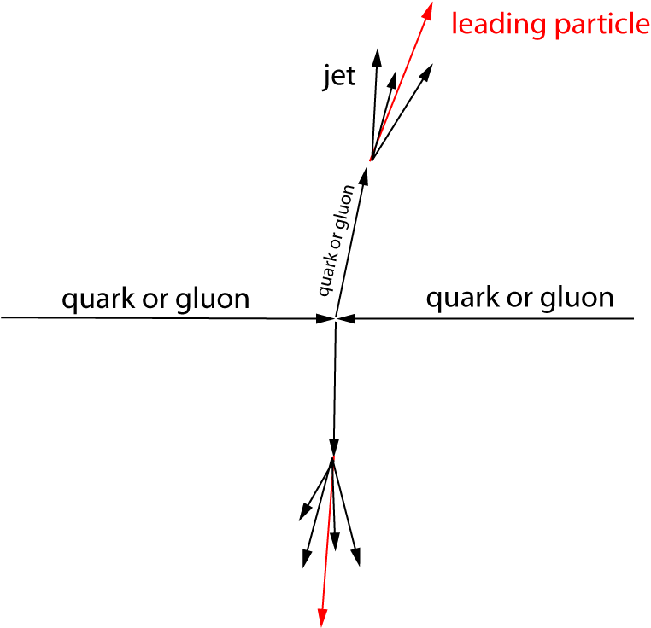
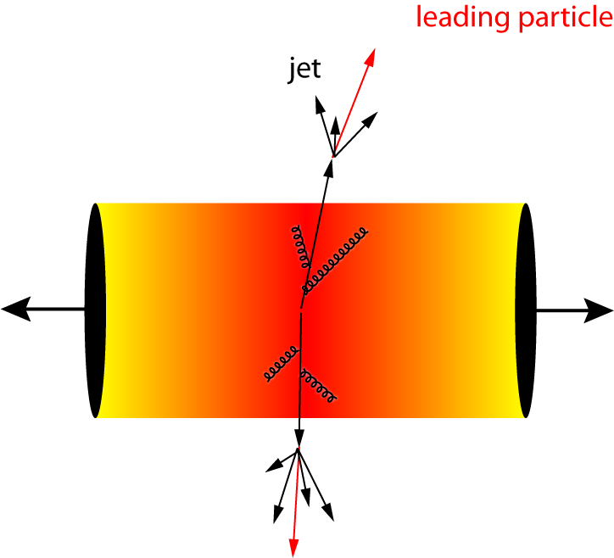
Probing hot and dense QCD matter
“Simplest way” to establish
the properties of a system
  calibrated probe
  calibrated interaction
  suppression pattern tells about density profile
Heavy-ion collision
  hard processes serve as calibrated probe (pQCD)
  traverse through the medium and interact strongly
  suppression pattern provides density measurement
  General picture: parton energy loss through medium-induced gluon radiation and collisions with medium constituents
Quark-Gluon
Plasma
pp collision
Pb-Pb collision
after the collision
Quantify medium effects with
nuclear modification factor
3

Slide 4
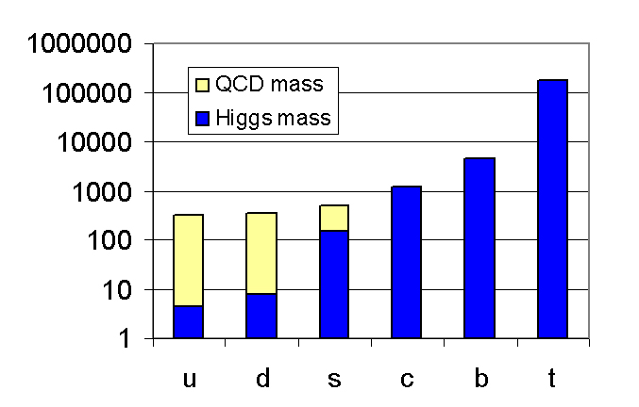
Heavy quarks are ideal probes
B. Müller, Nucl. Phys. A750, 84 (2005)
Symmetry breaking
  Higgs mass: electro-weak symmetry breaking → current quark mass
  QCD mass: chiral symmetry breaking → constituent quark mass
Charm and beauty quark masses are not affected by QCD vacuum → ideal probes to study QGP
Test QCD at transition from perturbative to non-perturbative regime: charm and beauty quarks provide hard scale for QCD calculations
Charm and beauty quarks are 250-450 times heavier than light quarks
They are abundantly produced at the LHC, predominantly in the early phase of the collisions
Production rates calculable in pQCD

Slide 5
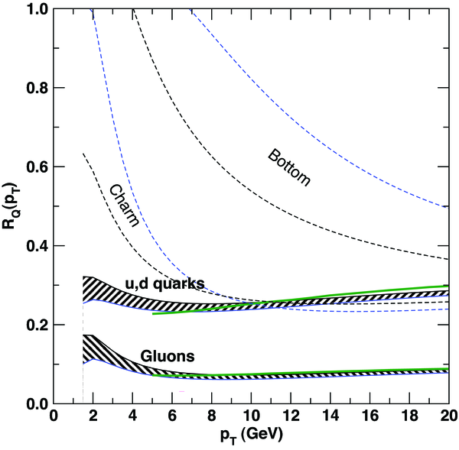
Energy loss of heavy quarks
(1) Radiative parton energy loss is colour charge dependent (Casimir coupling factor C_{R})
R. Baier et al., Nucl. Phys. B483, 291 (1997) (“BDMPS”)
(2) Dead-cone effect: gluon radiation suppressed at small angles (θ < m_{Q}/E_{Q})
Y. Dokshitzer, D. Kharzeev, PLB 519, 199 (2001), hep-ph/0106202
ΔE_{g} > ΔE_{u,d,s} > ΔE_{c} > ΔE_{b}
R_{AA}(π) < R_{AA}(D) < R_{AA}(B)
hot and dense QCD matter
parton
S. Wicks et al., Nucl. Phys. A784, 426 (2007)
beauty
charm
5

Slide 6
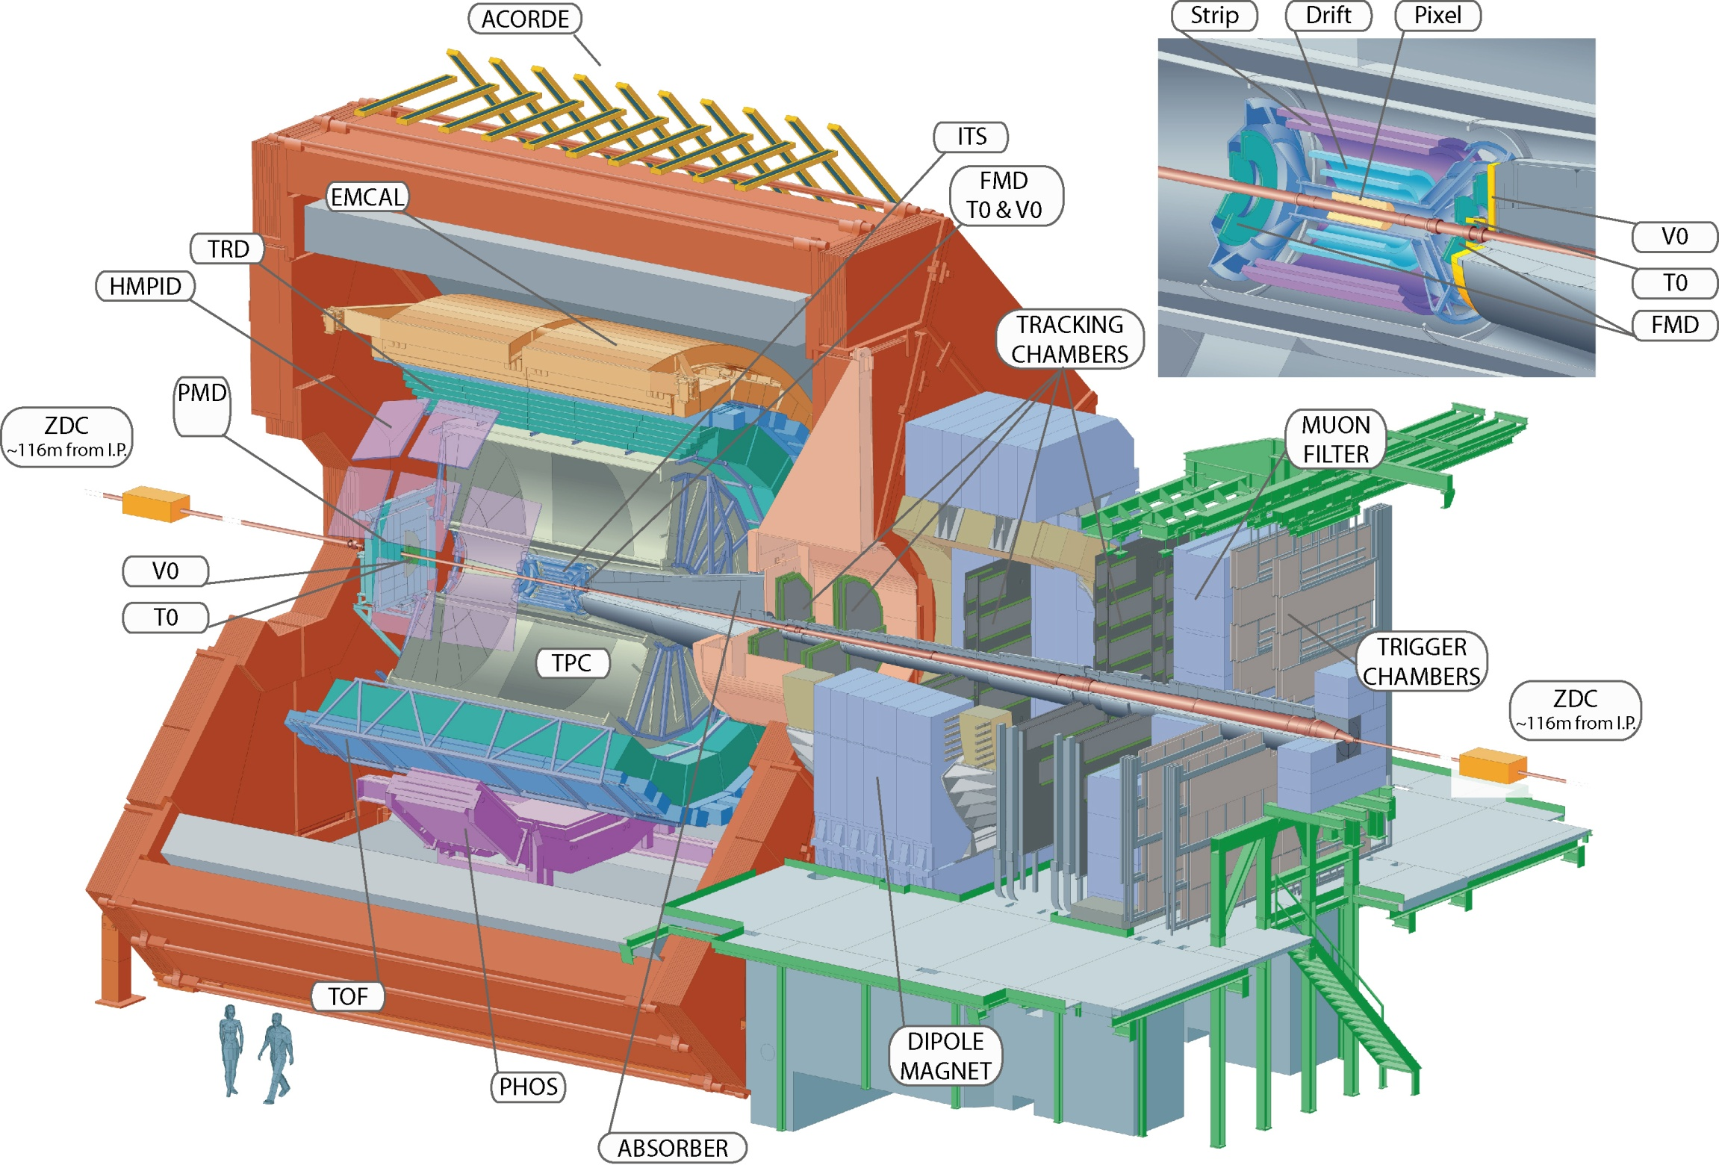
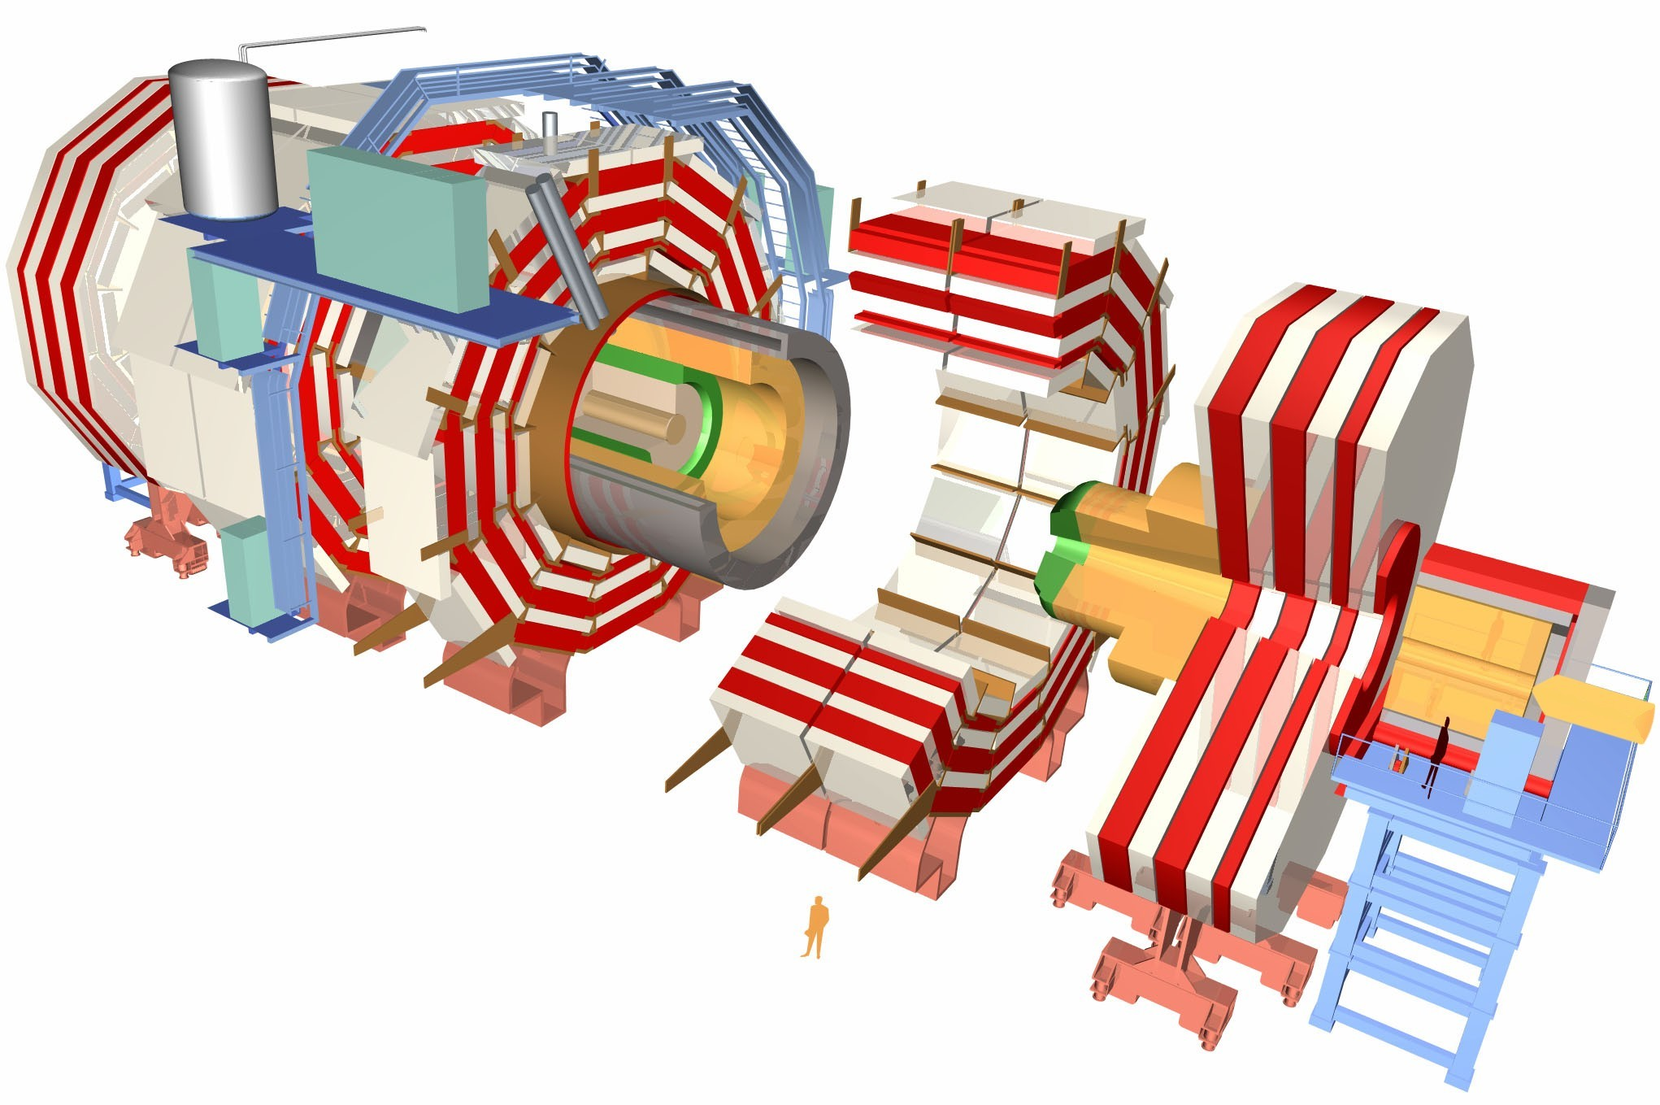


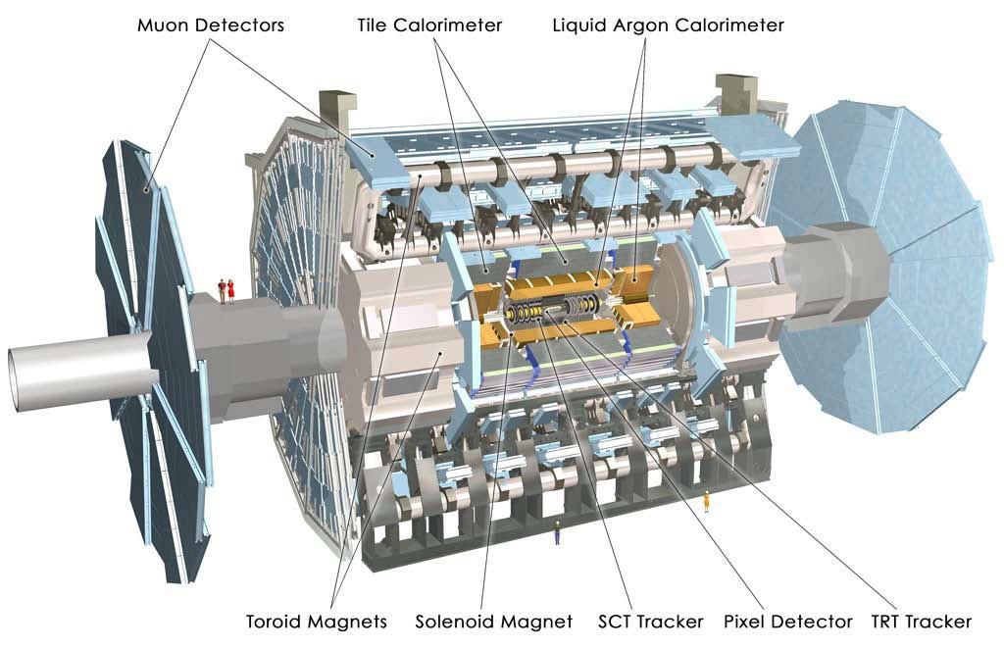

Experiments
Tracking (p_{T} resolution: 1-2%
up to p_{T} ~ 100 GeV/c) and calorimetry
Trigger selectivity over a large range in rapidity and full azimuth
PID over a very broad momentum range (>100 MeV/c)
Large acceptance in azimuth
Mid-rapidity coverage |η| < 0.9 and -4 < η < -2.5 in forward region
Impact parameter resolution better than 65 μm for p_{T} > 1 GeV/c
Three main subsystems with a full coverage in azimuth:
Inner Detector: tracking |η| < 2.5
Calorimetry |η| < 4.9
Muon Spectrometer |η| < 2.7

Slide 7
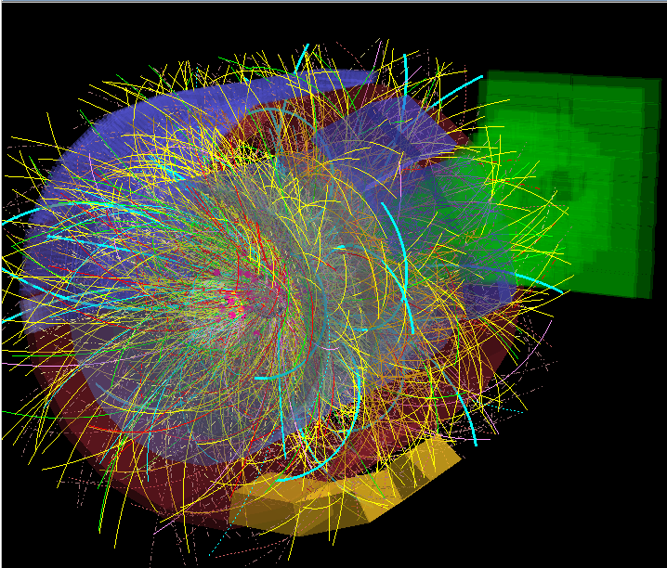
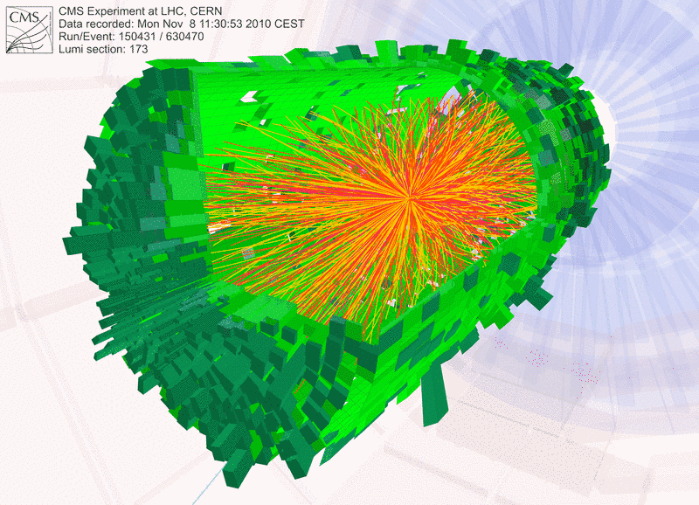
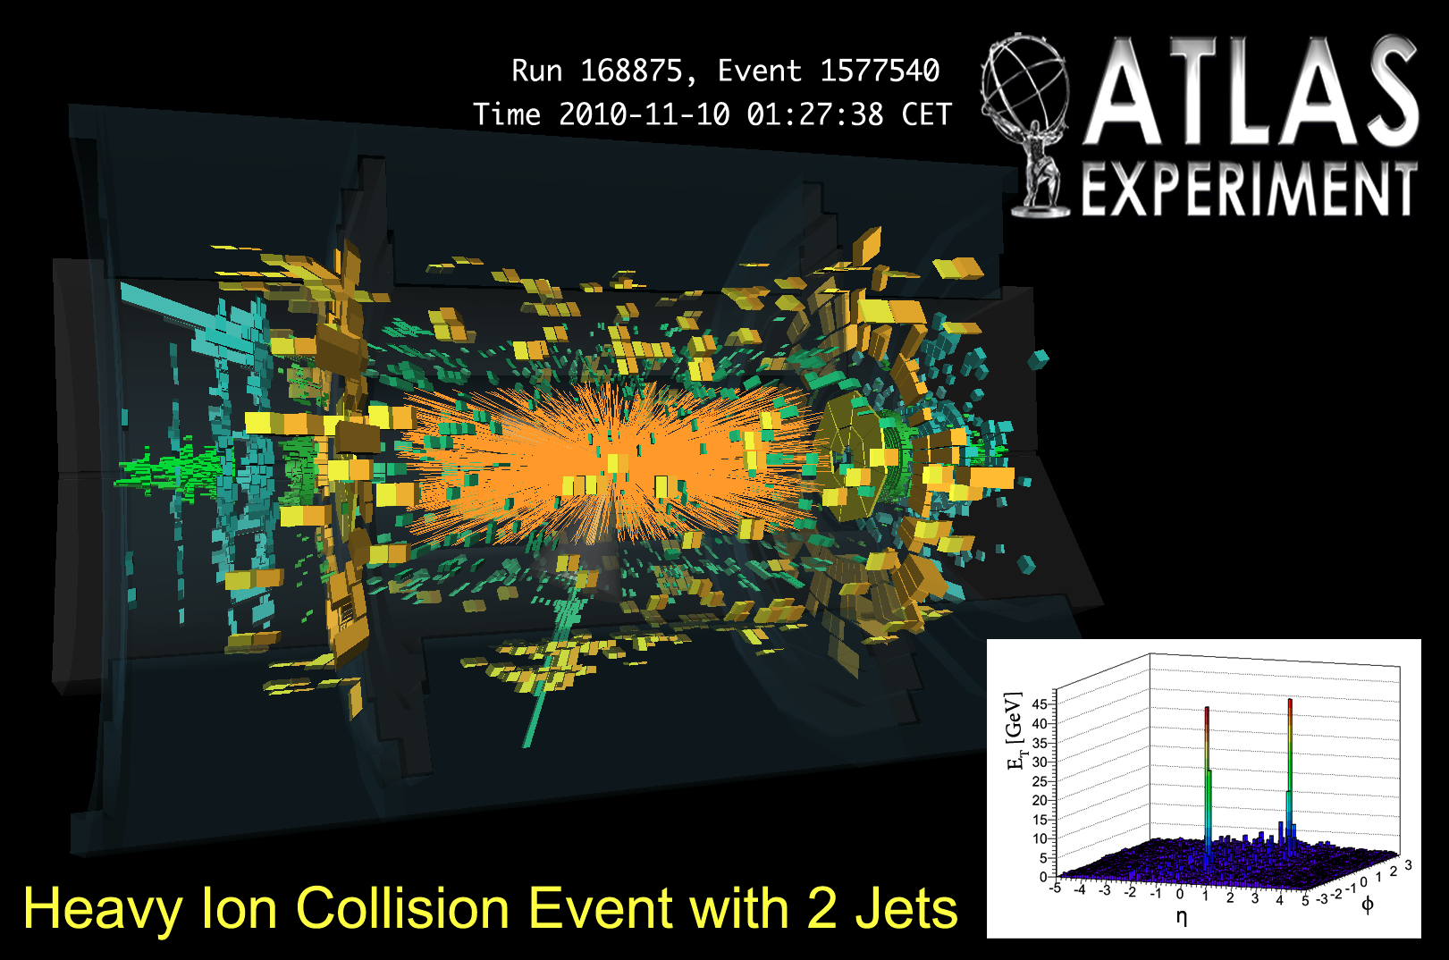
Typical event displays
Pb-Pb at √s = 2.76 TeV per nucleon-nucleon pair

Slide 8
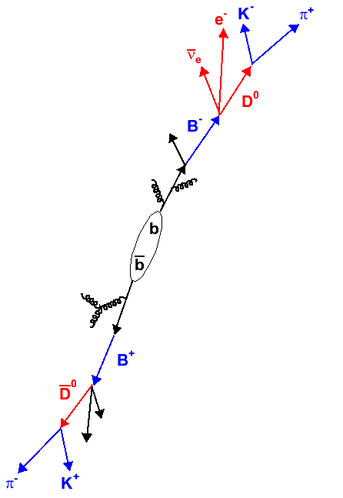
Detection of open heavy-flavour particles
Full reconstruction of open charmed mesons
e.g.: D⁰ → K⁻ + π⁺ BR = 3.89%, cτ = 123 μm
- direct clean probe: signal in invariant mass
distribution
- difficulty: large combinatorial background
especially in a high multiplicity environment
- mixed-event subtraction and/or vertex tracker needed
Semi-leptonic decay of D and B mesons
c → lepton + X BR = 9.6%
D⁰ → e⁺ + X BR = 6.87%
D⁰ → μ⁺ + X BR = 6.5%
b → lepton + X BR = 10.9%
- robust electron trigger
- needs handle on photonic electron background
Beauty via non-prompt J/ψ
f(c → D⁰) = 0.565 ± 0.032
f(c → D⁺) = 0.246 ± 0.020
f(c → D*⁺) = 0.224 ± 0.028
f(c → D_{s}⁺) = 0.080 ± 0.017

Slide 9
Total charm production cross section in pp
D^{*+}
Very good agreement between LHC experiments
Consistency with NLO pQCD calculations, although at the upper limit
Parton spectra from pQCD input for energy loss models
Baseline for measurements in Pb-Pb
D^{*+}
!
ALICE, JHEP 07, 191 (2012)
and JHEP 01, 128 (2012)
NLO: Mangano, Nason, Ridolfi, Nucl. Phys. B 373, 295 (1992)

Slide 10
D*± production in jets in 7 TeV pp
Phys. Rev. D 85 (2012) 052005
!
MC calculations fail to describe data at small z; strongest at low jet transverse momentum
Indication that jet fragmentation into D*⁺ not well modeled in current MC generators

Slide 11
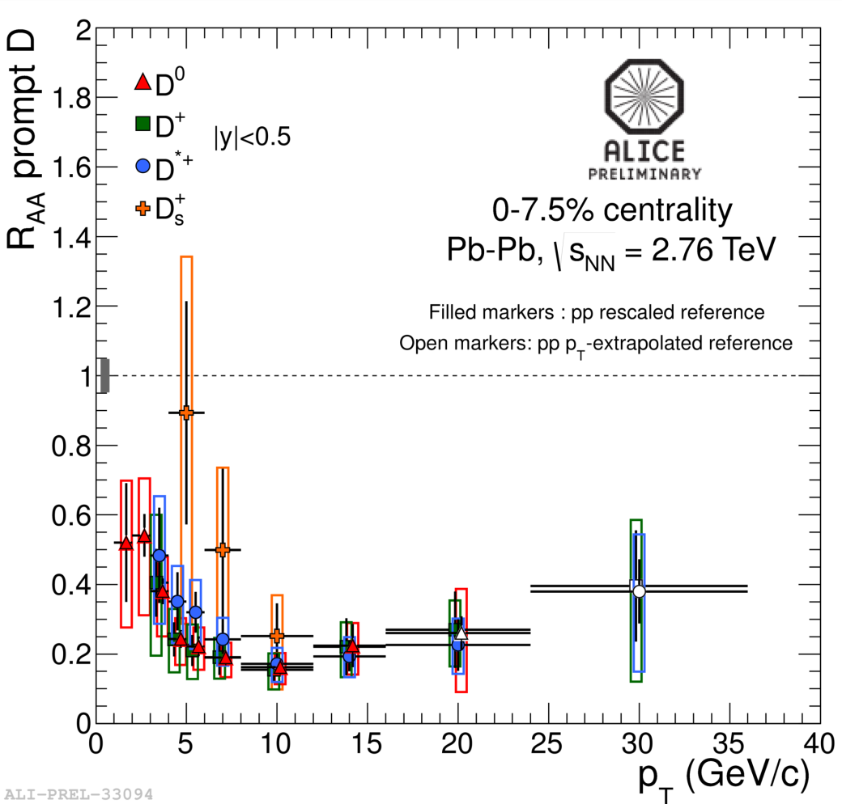
Prompt D meson R_{AA} in Pb-Pb collisions
D^{*+} D_{s}⁺
First D_{s}⁺(cs) measurement in heavy ion collisions
Expectation: enhancement of strange D meson yield at intermediate p_{T} if charm hadronizes via recombination in the medium
Strong suppression (factor 4-5) above 5 GeV/c in most central Pb-Pb, compared to binary scaling from pp
11
Notes:
General-Mass Variable Flavour Number Schemes, Kramer et al.

Slide 12
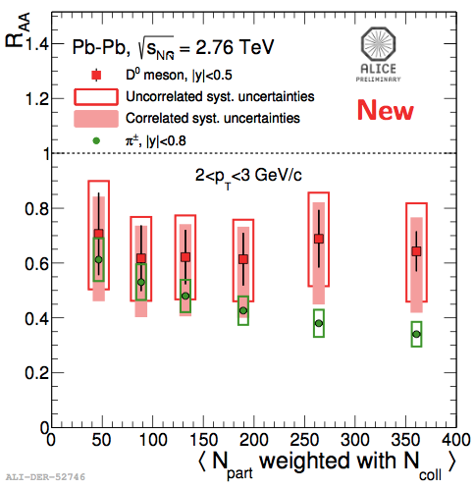
R_{AA}: light versus heavy quark hadrons
0-10%
D⁰
π±
R_{AA}^{D meson} > R_{AA}^{pions} at low p_{T}?
→ More data needed for final conclusion
12
Notes:
General-Mass Variable Flavour Number Schemes, Kramer et al.

Slide 13
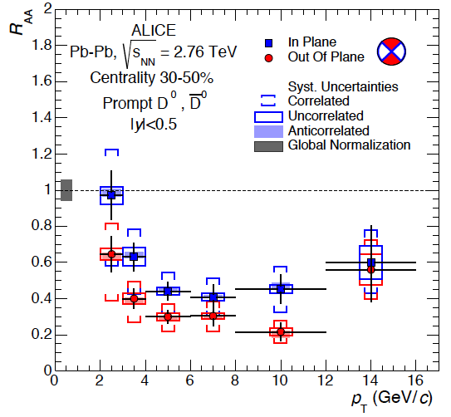
Prompt D⁰ meson R_{AA} versus event plane
z
x
y
out-of-plane
in-plane
More suppression at high p_{T} out-of-plane with respect to in-plane due to different path length

Slide 14
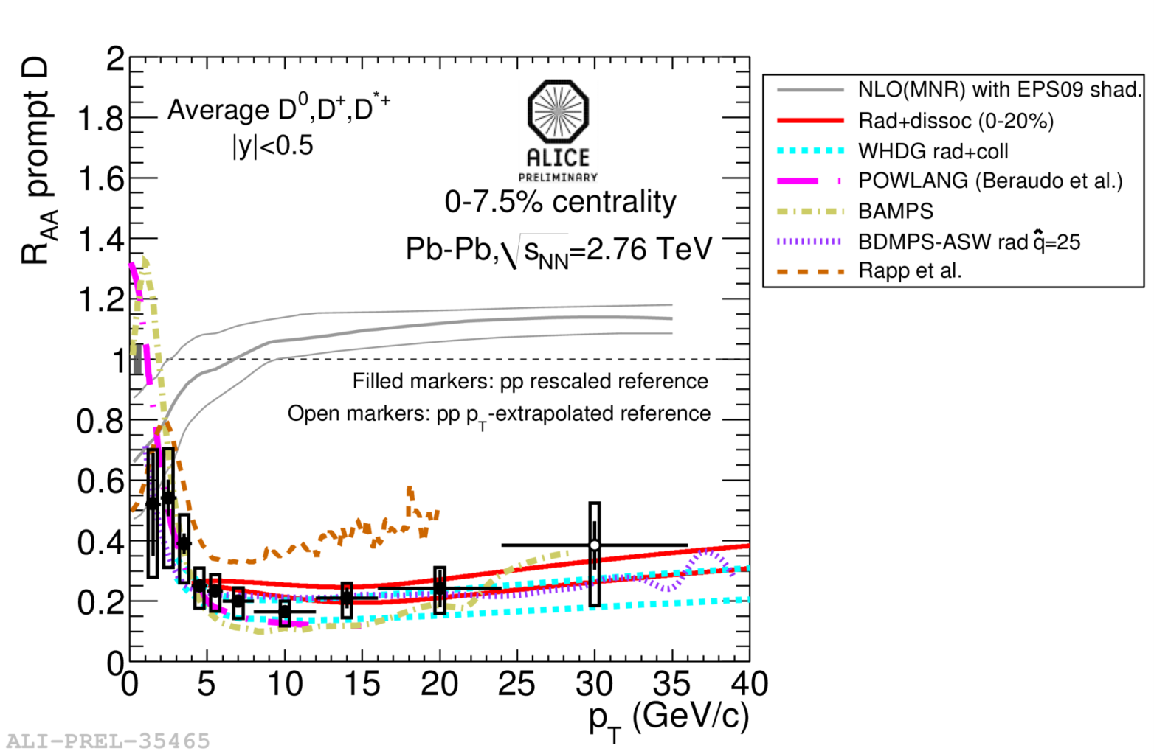
Comparison with model calculations
Energy loss models describe R_{AA} of prompt D mesons reasonably well
Indication for rising R_{AA}?
No/little shadowing (initial-state effect) is expected in this p_{T} range
Rad.+dissoc.: R. Sharma, I. Vitev and B.W. Zhang, Phys. Rev. C80, 054902 (2009), Y. He, I. Vitev and B.W. Zhang, Phys. Lett. B 713, 224 (2012)
WHDG (coll.+rad. Eloss in anisotropic medium): W.A. Horowitz and M. Gyulassy, J. Phys. G38, 124114 (2011)
POWLANG (coll. Eloss using Langevin approach): W.M. Alberico et al., Eur. Phyis J. C71,1666 (2011)
BAMPS (coll. Eloss in expanding medium): O. Fochler, J. Uphoff, Z. Xu and C. Greiner, J. Phys. G38, 124152 (2011)
Coll. + LPM rad. energy loss: P. B. Gossiaux, R. Bierkandt, and J. Aichelin, Phys. Rev. C79, 044906 (2009)
BDMPS-ASW: N. Armesto, A. Dainese, C.A. Salgado and U.A. Wiedemann, Phys. Rev. D71, 054027 (2005)
Coll. Eloss via D mesons resonances excitation + Hydro evolution: M. He, R.J. Fries and R. Rapp, Phys. Rev. Lett. 110, 112301 (2013)

Slide 15
p-Pb: measurement of initial state effects
Phys. Rev. Lett. 113 (2014) 232301 (publ. Dec. 2014)
p-Pb
Pb-Pb
Important baseline measurement of cold nuclear matter effects
(e.g., Cronin effect, nuclear shadowing, gluon saturation)
D meson R_{pA} shows consistency with unity and predictions from shadowing and CGC model predictions
High-p_{T} suppression of particle yield in Pb-Pb is a final state effect

Slide 16
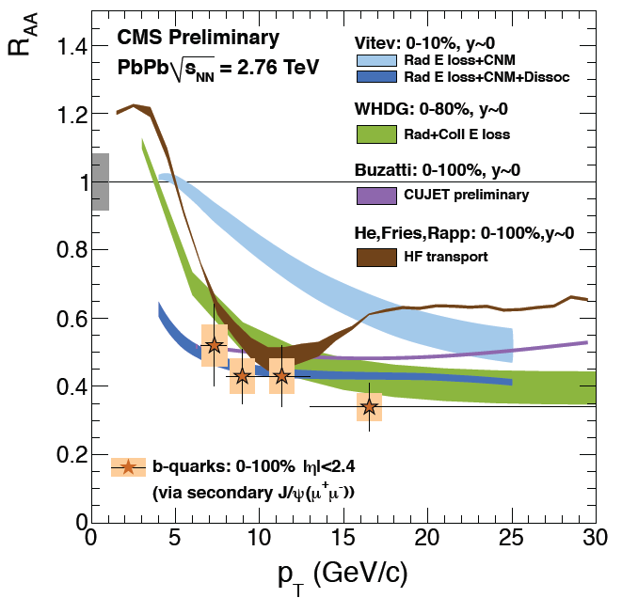
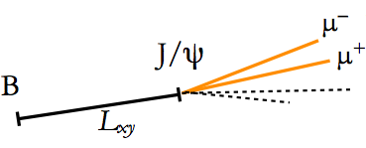
Beauty R_{AA} via non-prompt J/ψ
CMS PAS HIN-12-014
Non-prompt J/ψ in the most central collision (0-10%) is suppressed by a factor of 2.5
More data needed

Slide 17
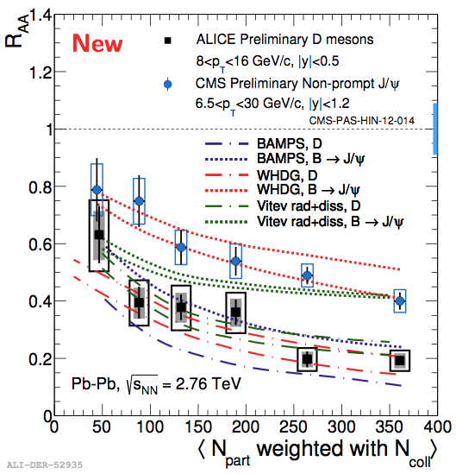
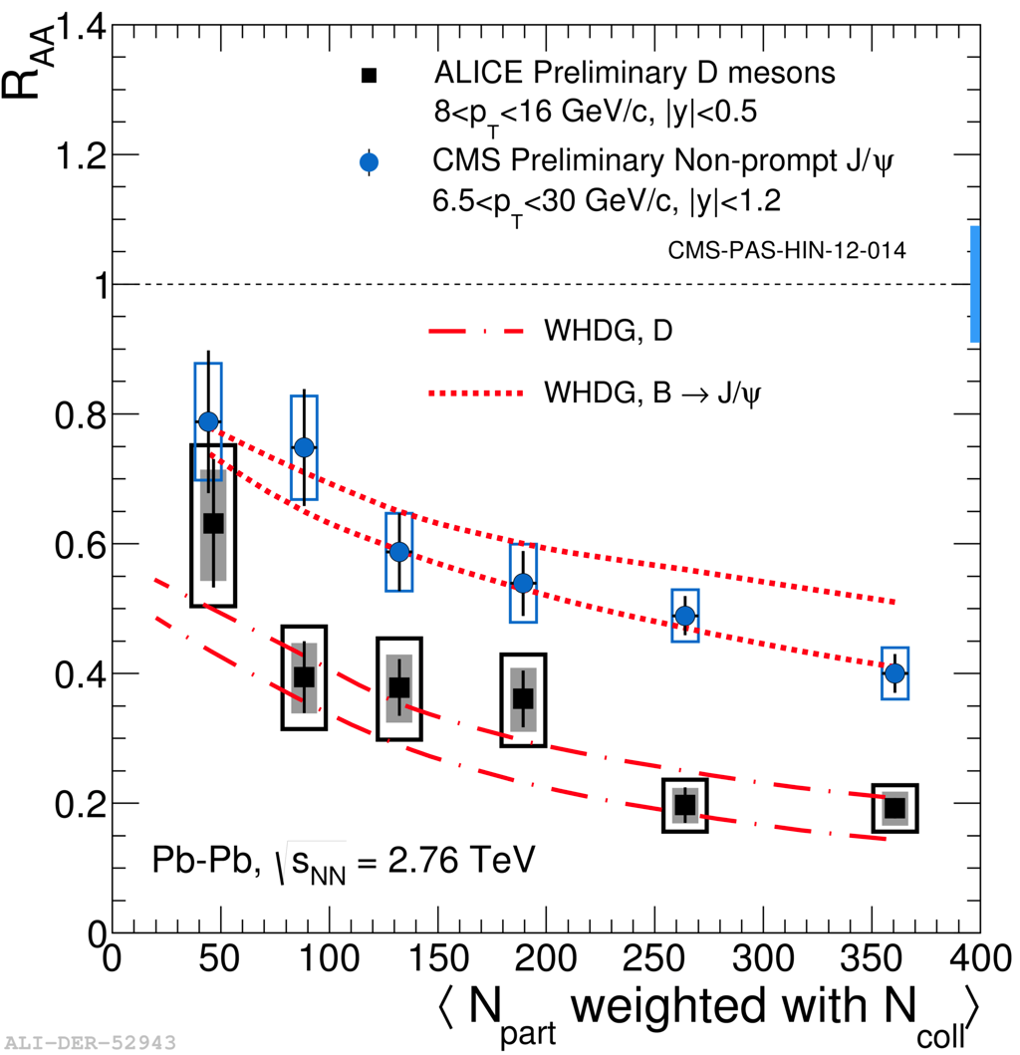
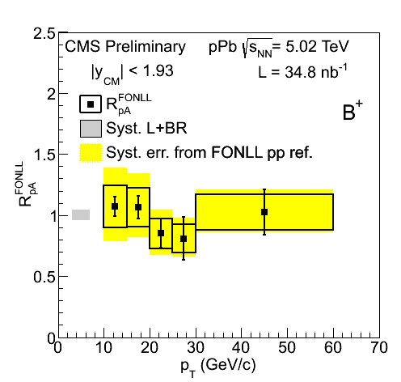
R_{AA} of D and B mesons
Comparison of prompt
D mesons (ALICE) with J/ψ from beauty decays (CMS)
D and B meson <p_{T}> ~10 GeV/c
First indication of the mass dependence of the parton energy loss: R_{AA}^{D} < R_{AA}^{B}
B
D
First open beauty measurement in p-Pb by CMS (QM 2014)

Slide 18
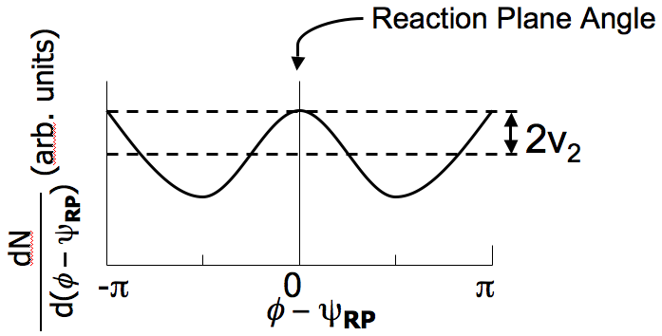
Azimuthal anisotropy
z
p_{y}
pressure and
multiple collisions
p_{x}
x
y
coordinate space: momentum space:
initial anisotropy final anisotropy
Multiple interactions lead to thermalisation → hydrodynamic behavior of the system
Pressure gradient generates collective
flow → anisotropy in momentum space
Fourier decomposition:
Andre Mischke (Utrecht)
18

Slide 19
Azimuthal anisotropy of prompt D mesons
Phys. Rev. Lett. 111 (2013) 102301
Indication (3-5σ confidence level) for non-zero charm elliptic flow in the p_{T} range 2-6 GeV/c

Slide 20
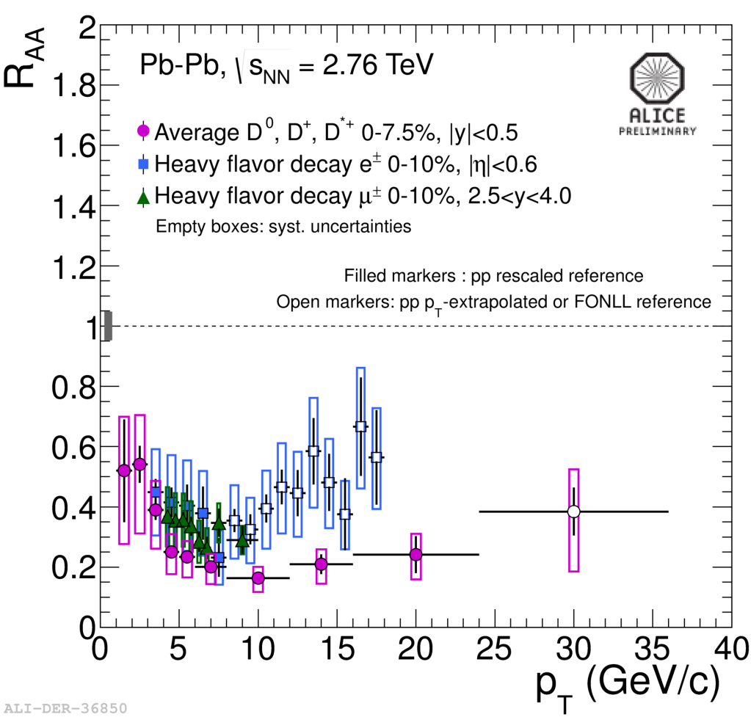
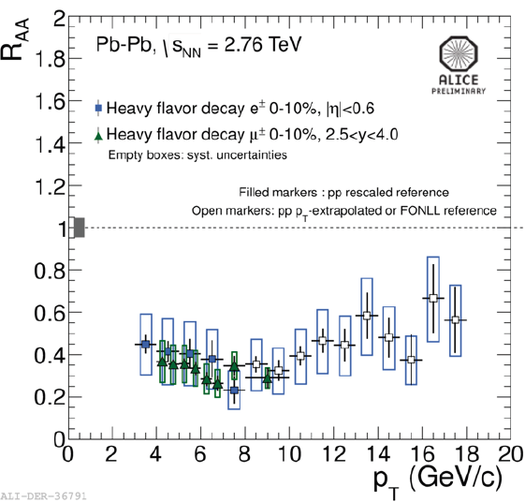
Heavy flavour decay muons and electrons
Strong suppression of high-p_{T} muon yield from heavy flavour decays
No significant dependence on p_{T} in 4 < p_{T} < 10 GeV/c
Similar to single electron and D meson R_{AA} at central rapidity
R_{AA}^{single e} > R_{AA}^{D} at
p_{T} > 8 GeV/c due to beauty contribution
Relative beauty contribution to single electron yield from electron-hadron azimuthal correlations
4 6 8 10
p_{T} (GeV/c)
Phys. Lett. B 738 (2014) 97

Slide 21
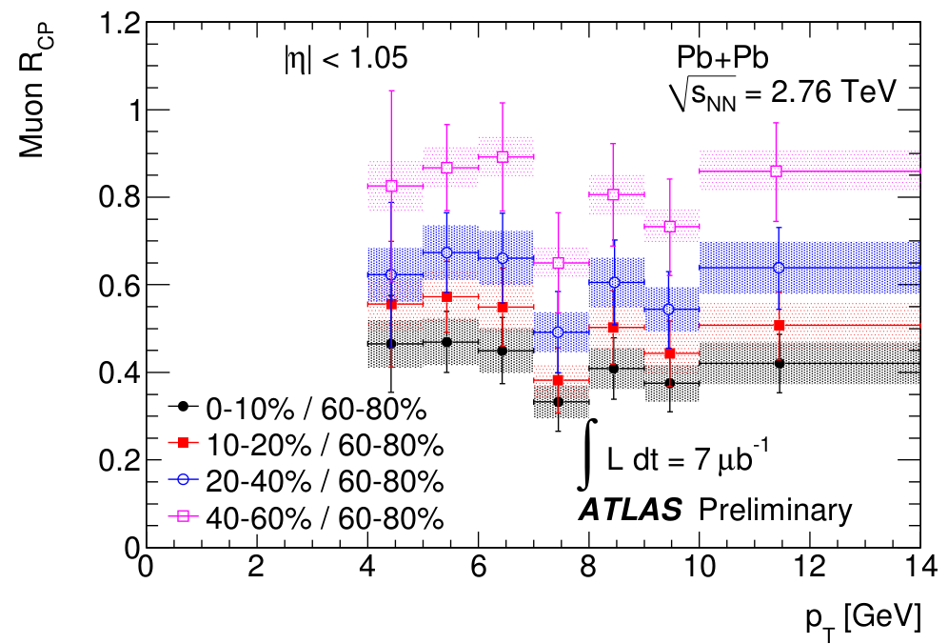
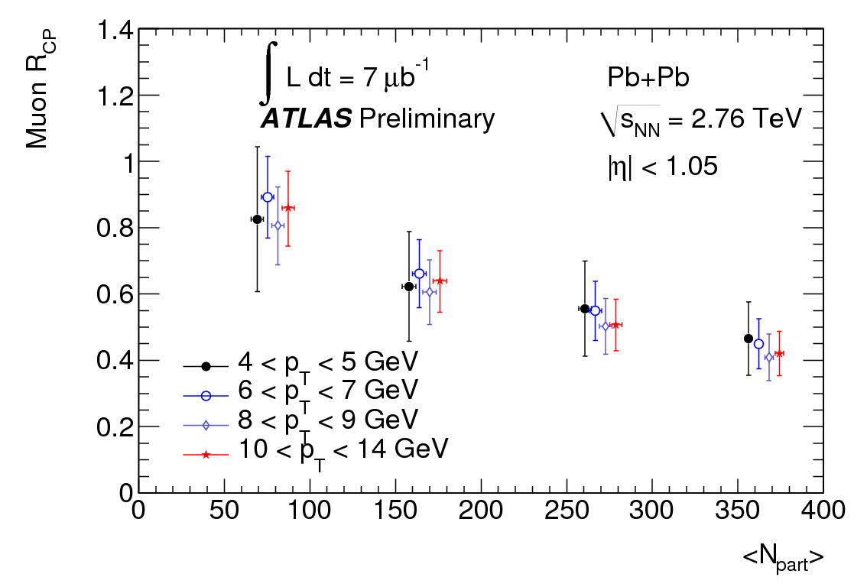
ATLAS: R_{CP} of heavy-flavour decay muons
A factor of 2 suppression 0-10%/60-80%, independent of p_{T}
Indications for weaker suppression than for charged hadrons and as compared to RHIC electron results

Slide 22
Single electron R_{AA} and v₂ at mid-rapidity
Strong suppression of single electron yield up to 18 GeV/c in 10% most central events (R_{AA}~0.4)
→ substantial energy loss of heavy quarks in the medium
Non-zero v₂ observed in 20-40% central events
→ suggests strong re-interactions within the medium
Energy loss models need to simultaneously describe v₂ and R_{AA}; → more difficult with more precision and more observables, such as azimuthal angular correlations

Slide 23
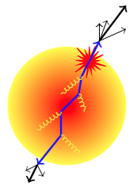

Heavy-quark particle correlations in Pb-Pb
Δφ = π Δφ =0
Heavy-flavour decay electron-hadron angular correlations
  Near side (Δφ=0) sensitive to fragmenting jet leaving the medium
  Away side (Δφ=π) sensitive to recoiling parton that survives the traversal through the medium
Agreement with RHIC measurement
Full exploration with Run2 data (5.1 TeV)

Slide 24
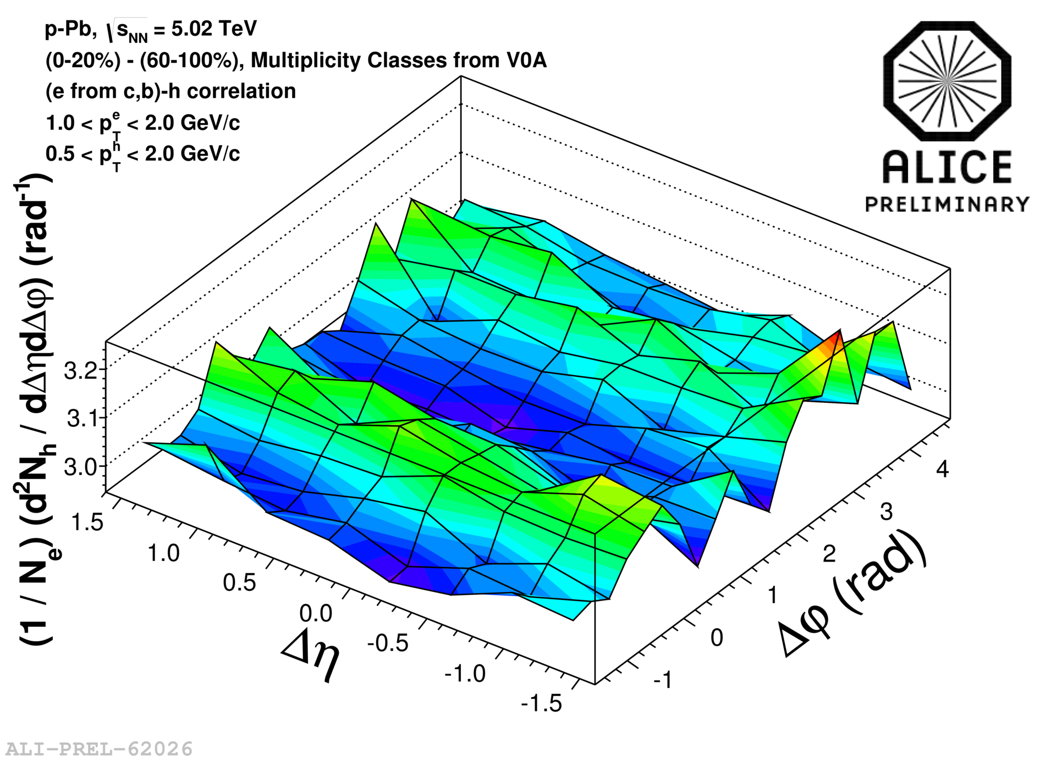
Unexpected result: e-h correlations in p-Pb
Most central events have higher correlation yield for
low-p_{T} electrons
Indication for long-range correlation in Δη; also seen for light flavours
Hydrodynamics or CGC?
Advanced model calculations needed
!
Azimuthal angular correlation between heavy-flavour decay electrons and charged hadrons
Difference of the correlation distribution for high and low multiplicity events

Slide 25
Summary
Heavy quarks are particularly good probes to study the transport properties (drag and diffusion coefficient)
  Lots of data from first Pb-Pb run at √s_{NN} = 2.76 TeV
  R_{AA} and v₂ of prompt D mesons and single leptons
  strong suppression of the yield at high p_{T} observed in most central collisions → more insight on energy loss mechanisms
  non-zero elliptic flow → strong re-interactions within the medium
  b-quark energy loss via B→J/ψ
    - R_{AA}(π) ~ R_{AA}(D, single leptons) < R_{AA}(B→J/ψ)
Precision measurements needed to further constraint model calculations (and open beauty!)
Many more exciting results ahead of us
  - LHC Run2 (5.1 TeV, 2015-2018) and upgrades (2018/19)
25

Slide 26
Thank you
26

Slide 27
Backup
27

Slide 28
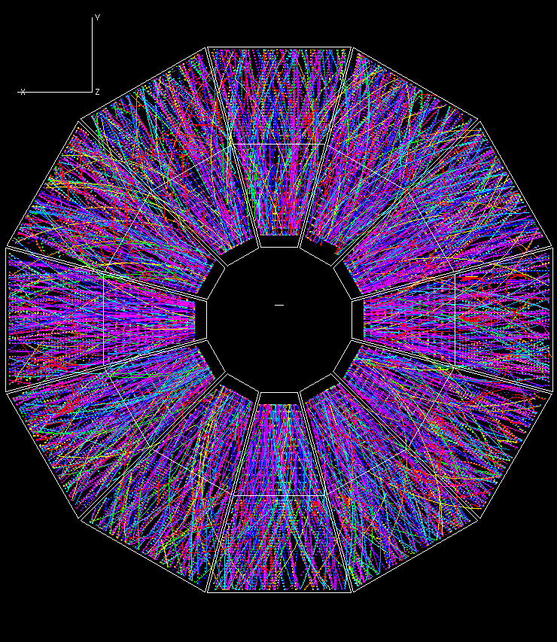
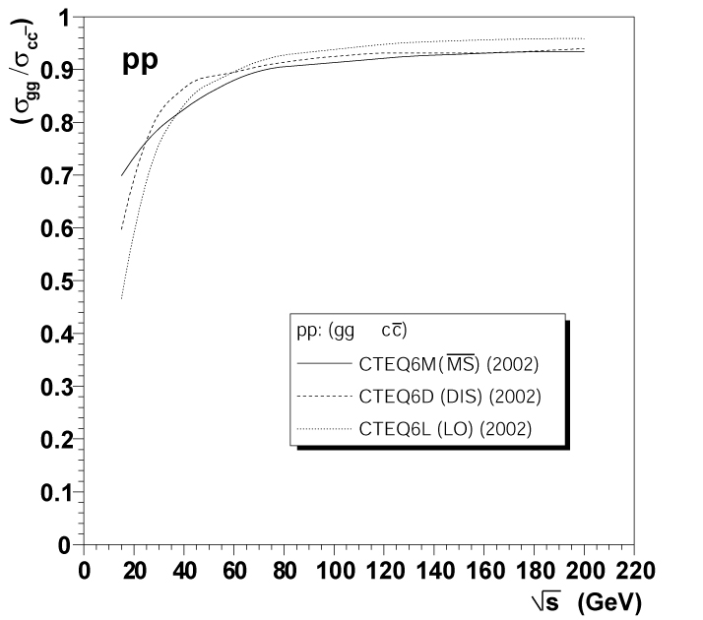
Time evolution
Thermalization
of QGP
Hadronisation:
QGP lifetime?
Quarkonia melts
and flow develops
~0.1
~1
~10
10¹⁵
time scale (fm/c)
Parton energy loss
Charm production
τ ~ h/2m_{Q}
Gluon fusion dominates → sensitivity to initial state gluon distribution M. Gyulassy and Z. Lin, Phys. Rev. C51, 2177 (1995)
Heavy quarks transverse through the QCD medium and interact strongly with it → energy loss
Due to their mass (m_{Q} >> T_{c}, Λ_{QCD}) → higher penetrating power
Charm,
PYTHIA 6.208

Slide 29
Tentative LHC schedule
2010/11 Long run with pp collisions at 7 TeV
1 month of Pb-Pb collisions each year
2012 Long run with pp at 8 TeV
2013 p-Pb at 5.023 TeV (control measurement)
2013/14 Long shutdown: machine consolidation
2015-2018 pp, p-Pb and Pb-Pb at almost full energy
2018/19 Long shutdown: luminosity and detector
upgrades
2019-2022 pp, p-Pb and Pb-Pb at high luminosity

Slide 30
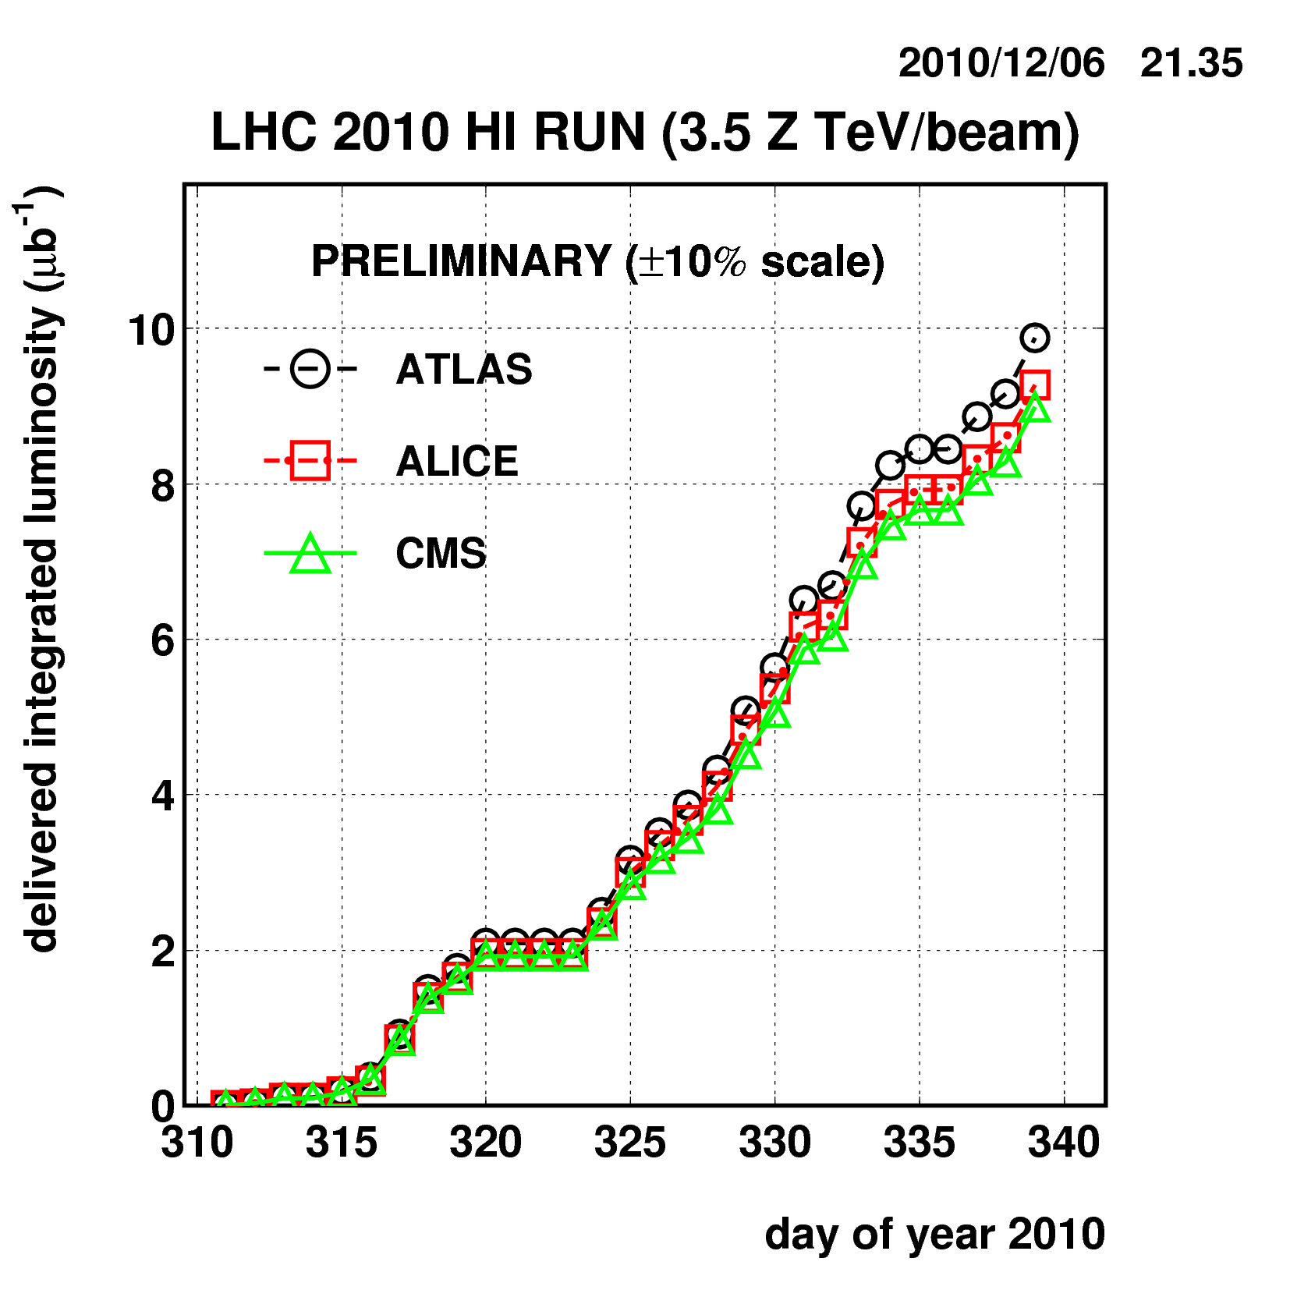
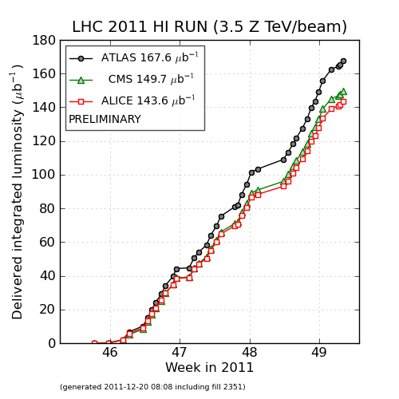
Data: integrated luminosity
year | integrated luminosity
2010 | ~ 10 mb⁻¹
2011 | ~ 0.16 nb⁻¹
Pb- Pb at √s_{NN} = 2.76 TeV
208
82
208
82
2010 → 2011: factor 16 improvement

Slide 31
ALICE data sets
System | √s_{NN} (TeV) | Year | Data analyzed
pp | 7 | 2010 | 5 nb⁻¹
pp | 2.76 | 2011 | 1.1 nb⁻¹
Pb-Pb | 2.76 | 2010 | 2.12 μb⁻¹
Pb-Pb | 2.76 | 2011 | 28 μb⁻¹ central 6 μb⁻¹ semi-peripheral
p-Pb | 5.02 | 2013 | 48.6 μb⁻¹

Slide 32
Experiment | Heavy flavor | Quarkonia | Electroweak
PHENIX | μ: 1.2<|y|<2.2 e: |y|<0.35 | J/ψ, ϒ→μμ J/ψ, ϒ→ee | γ, di-electron
STAR | e, D: |y|<1 | J/ψ, ϒ→ee | di-electron
ALICE | μ: 2.5<|y|<4 e,D: |y|<0.9 B→J/ψX→eeX | J/ψ→ μμ J/ψ→ ee | γ
ATLAS | μ: |y|<1.05, p_{T}>4 GeV/c |  | γ: |y|<1.3, E_{T} (45-200 GeV) W→μν: |η^{μ}|<2.7,p_{T}(μ)>7 GeV/c Z→µµ (ee): |y|<2.7 (|y|<2.5)
CMS | B→J/ψX→μμX | J/ψ→μμ: |y|<2.4, p_{T}>6.5 GeV/c ϒ→μμ |y|<2.4 | γ: |y|<1.44, E_{T} (20-80 GeV) W→μν: |η^{μ}|<2.1,p_{T}(μ)>25 GeV/c Z→μμ: |y|<2.1
32

Slide 33
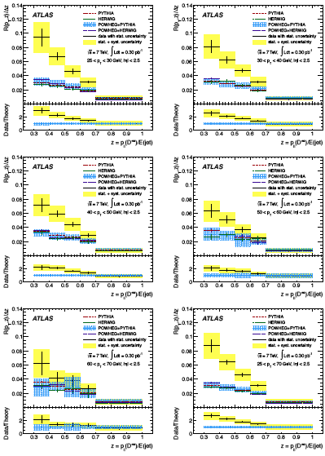

Slide 34
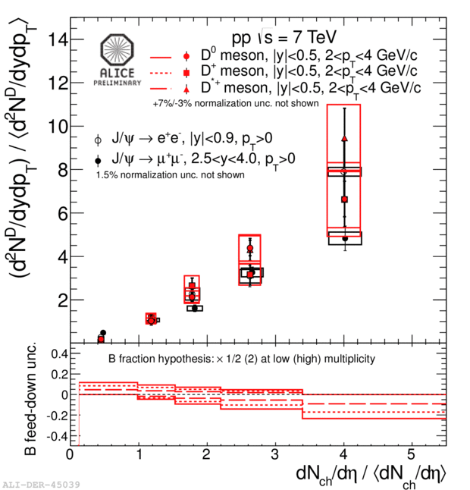
Multiplicity dependence of D and J/ yields in pp
Linear increase of
D-meson yields with charged multiplicities
Similar behaviour for D mesons and J/
(Phys. Lett. B 712, 165 (2012))
No p_{T} dependence
Due to multi-parton interactions?
Particle multiplicity

Slide 35
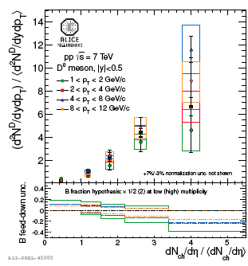

Slide 36
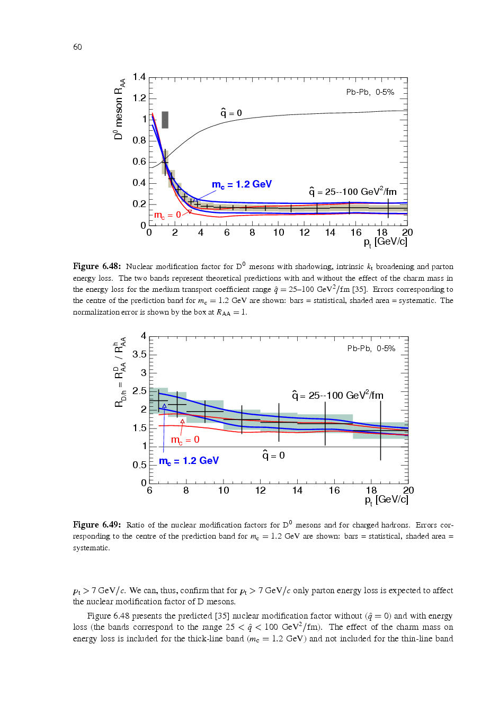
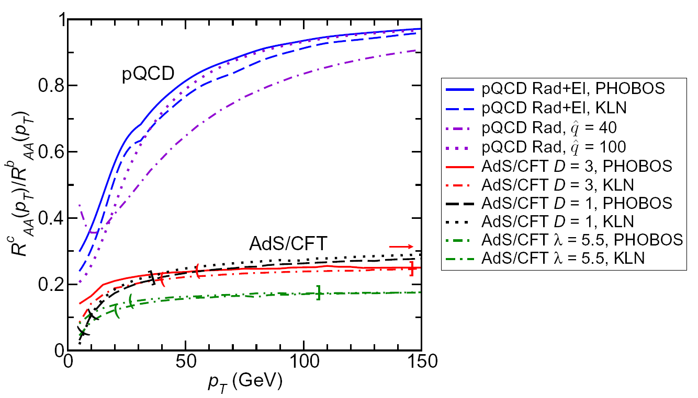
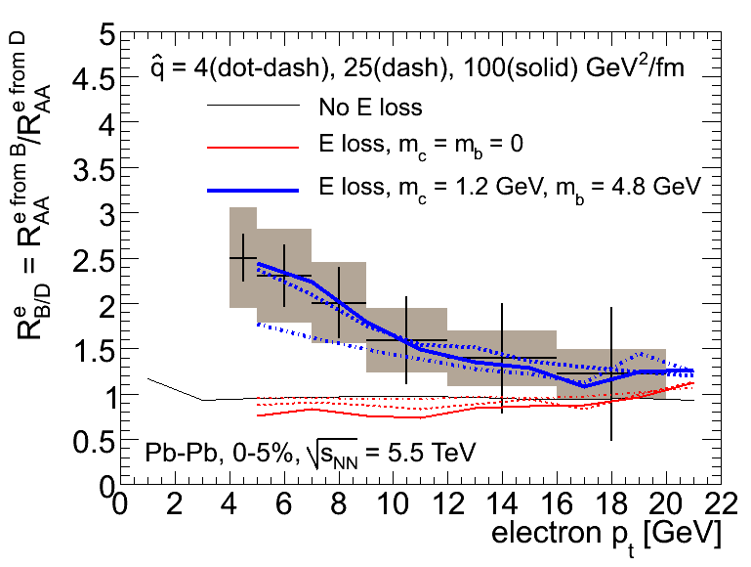
Explore energy loss mechanisms in more detail
MC simulations
Colour charge dependence
Mass dependence (dead cone effect)
C_{R} is 4/3 for quarks
and 3 for gluons
R^{c}_{AA}/R^{b}_{AA} ratio different for pQCD and AdS/CFT

Slide 37
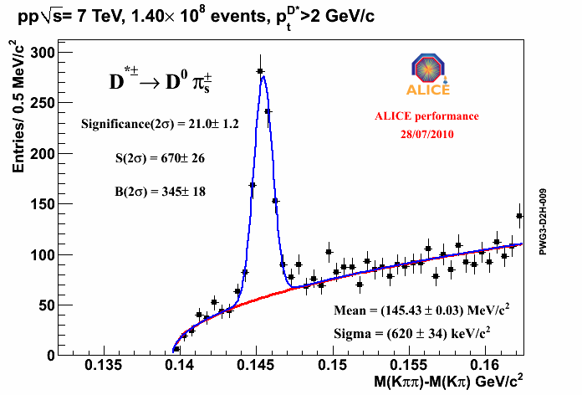
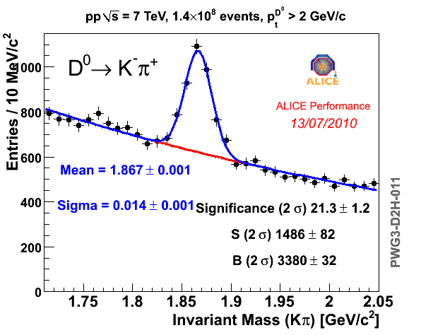
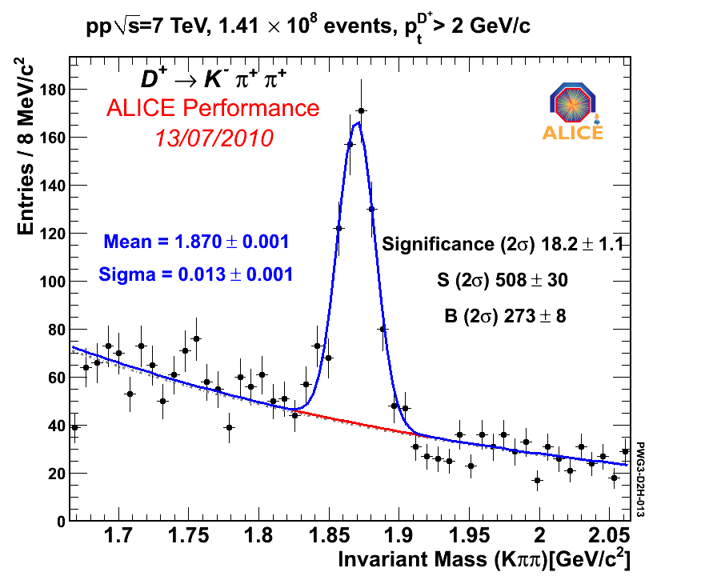
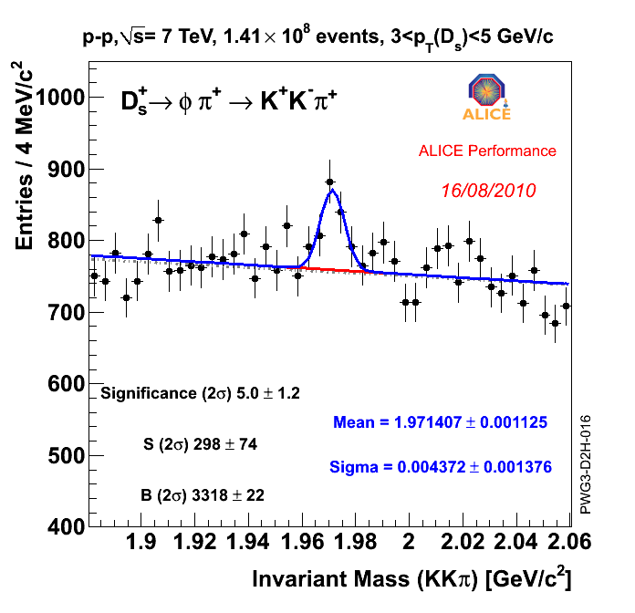
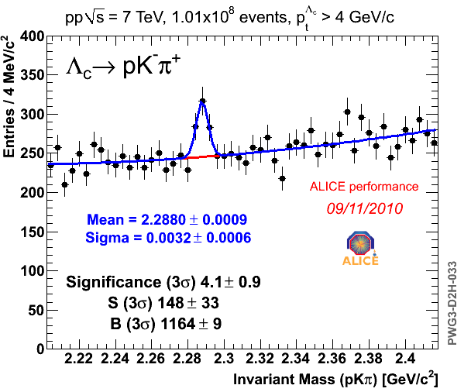
Open charm signals in 7 TeV pp collisions
37

Slide 38
D meson cross sections in 7 TeV pp
|η| < 0.5
D⁰ D*⁺ D⁺
Paper accepted by JHEP,
arXiv:1111.1553
p_{T} range: 1-24 GeV/c with 5 nb⁻¹
Data well described within uncertainties by NLO pQCD calculations: - FONLL, M. Cacciari et al., JHEP 0103 (2001) 006
        - GM-VFNS, B.A. Kniehl et al., PRL 96 (2006) 012001
Notes:
general-mass variable flavor-number scheme (GM-VFNS)

Slide 39
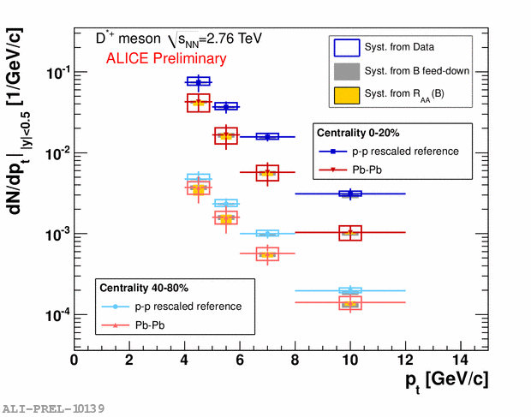
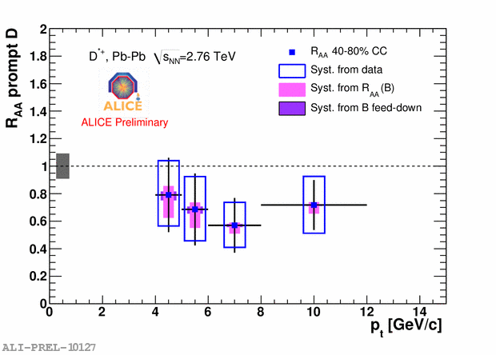
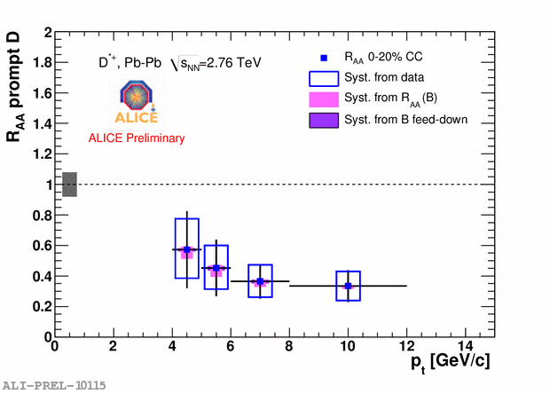
p_{T} spectra and R_{AA} for prompt D*⁺
Strong suppression observed in central (0-20%) Pb-Pb
Less suppression in 40-80% Pb-Pb
suppression
39

Slide 40
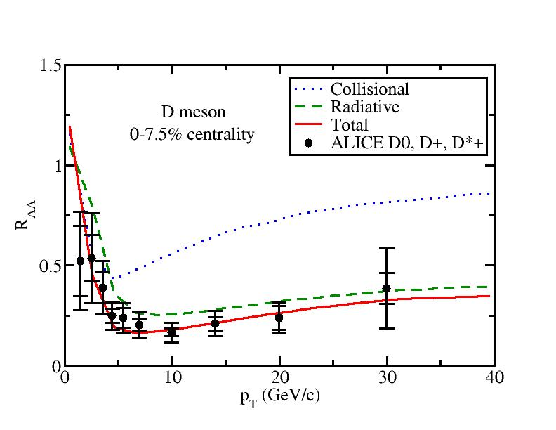
Shanshan Cao (Duke), QM 2012
Heavy quark evolution and flow: Langevin approach incorporating gluon radiation mechanism
40

Slide 41
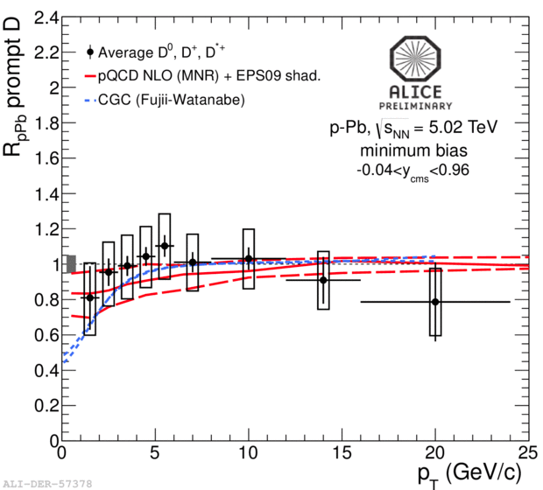
p-Pb: measurement of initial state effects
p-Pb
Pb-Pb
NLO: Nucl. Phys. B373, 295 (1992)
EPS09: K.J. Eskola H. Paukkunen and C.A. Salgado,
JHEP 0904, 065 (2009)
CGC: H. Fujii and K. Watanabe, NPA 920, 78 (2013)
Important baseline measurement of cold nuclear matter effects
(e.g., Cronin effect, nuclear shadowing, gluon saturation)
D meson R_{pA} shows consistency with unity and predictions from shadowing and CGC model predictions
High-p_{T} suppression of particle yield in Pb-Pb is a final state effect

Slide 42
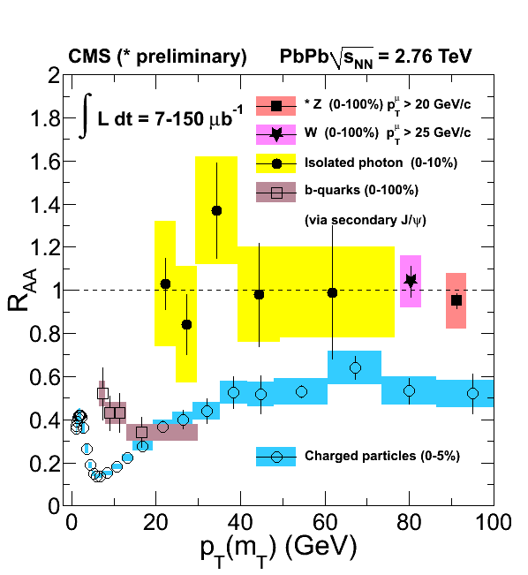
Beauty R_{AA} via non-prompt J/ψ
CMS, Z boson: CMS PAS HIN-12-008
Z⁰ → μ⁺μ⁻
W → μν using single muon recoil against missing p_{T}
Z, W and γ production consistent with N_{coll} scaling (R_{AA}≈1) → not sensitive to the medium
Non-prompt J/ψ in the most central collision (0-10%) is suppressed by a factor of 2.5

Slide 43
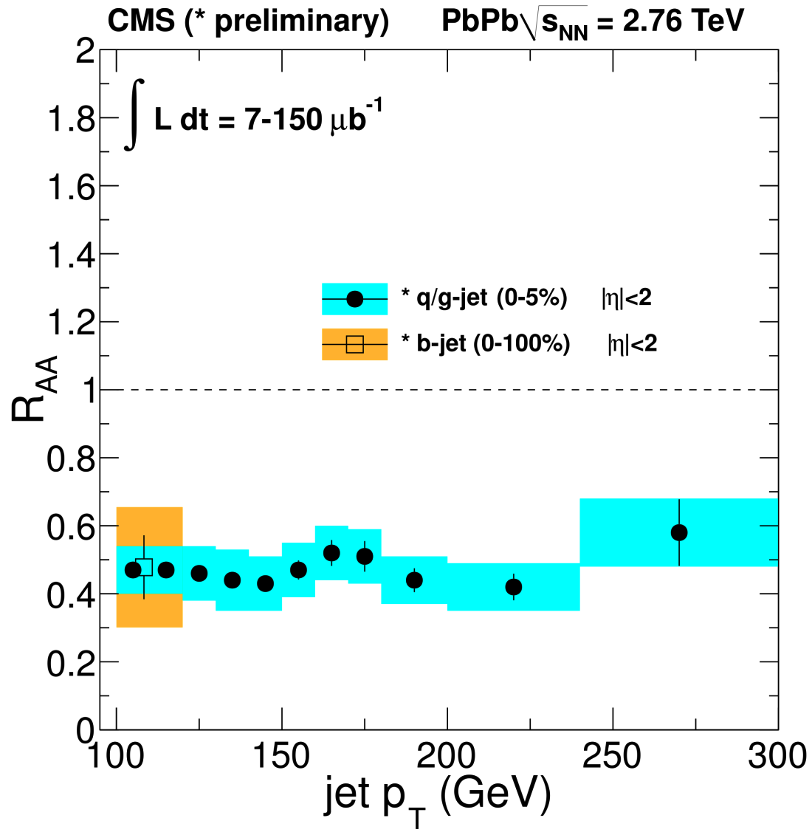
Inclusive and b-jets
Distinct b-quark suppression pattern at low p_{T}
First observation of b-jet suppression at high p_{T}

Slide 44
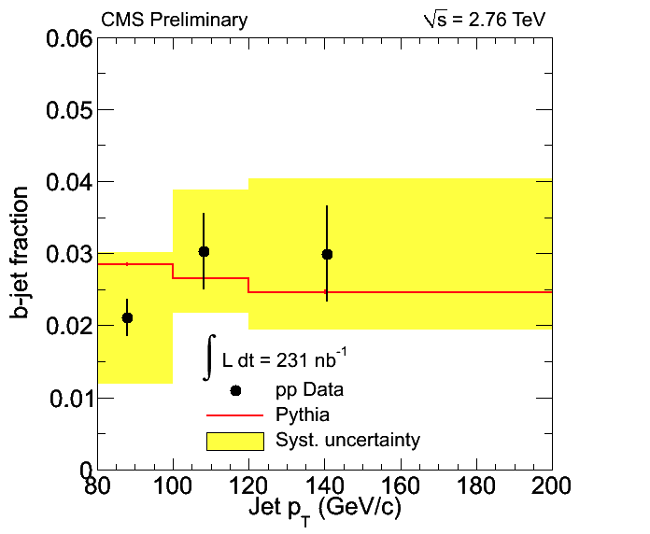

b-tagged jets
CMS-PAS HIN-12-003
Jets from b-quark fragmentation are identified for the first time in heavy ion collisions
  Jets are tagged by their secondary vertices
  b-quark contribution is extracted using template fits to their secondary vertex mass distributions

Slide 45


Single muons: analysis procedure
charm, beauty
π, K primaries
π, K secondaries
punch-through
Muon
sources
Remove hadrons and low-p_{T} muons (secondary π, K) by requiring muon tracking-trigger
Remove decay muons (primary π, K) by subtracting MC dN/dp_{T} normalized to data at low p_{T} (< 2 GeV/c)
Remaining contribution are muons from charm and beauty
Corrections on acceptance x efficiency (~80% for p_{T} > 2 GeV/c)

Slide 46

Upgrade of the ALICE Inner Tracker
New Inner Tracking System based on 7 silicon layers
Factor 3 improvement in impact parameter resolution
Low material budget
(X/X₀ ≤ 0.3% for first 3 inner silicon layers possible)
Installation in LS2 (2018/19)

Slide 47


Open heavy-flavour reconstruction
Impact parameter resolution
SSD
SDD
SPD
87.2 cm
Radius inner
pixel layer: 3.9 cm
≈1 cm from the vacuum
Inner Tracking System (ITS)
6 layers of silicon detectors
- aligned using cosmics
and first pp data
- current resolution for pixels:
14 μm (nominal ≈11 μm)
- X/X₀ = 7.7% for radial tracks
Capabilities to measure open charm down to p_{T}=0 in pp and p-Pb (1 GeV/c in Pb-Pb)
High precision tracking, better than 65 μm for p_{T} > 1 GeV/c
47

Slide 48


Particle Identification
Specific ionisation energy loss; PID based on comparison with Bethe-Bloch curves
TPC dE/dx
σ ≈ 5-6%
PID based on comparison of time of flight with particle mass hypothesis
TOF (150k channels)
σ ≈ 90 ps
48

Slide 49


Single electrons at mid-rapidity
High quality tracks in TPC and ITS
  - hit in innermost pixel layer to reduce γ conversions
Electron identification using TPC and TOF
  TOF to reject Kaons (<1.5 GeV/c) and protons (<3 GeV/c)
  TPC: asymmetric cut around the electron Bethe-Bloch curve
Background is subtracted using the cocktail method

